Slide 1



ETHICAL FRAMEWORK FOR BUSINESS
Module -2
Ms. Ifra Fathima I
Assistant Professor

Slide 2
The role of professional bodies
The International Federation of Accountants (IFAC):
Represents major accountancy bodies worldwide.
Protects the public interest by developing high-quality international standards.
Promotes strong ethical values and encourages quality practice in the profession.
IFAC’s International Ethics Standards Board for Accountants (IESBA):
An independent body that sets global ethical standards for professional accountants.
Develops and issues the Code of Ethics for Professional Accountants.
Supports adoption and implementation of ethical practices and fosters global discussions on ethical issues.

Slide 3
The Financial Reporting Council (FRC):
The UK’s independent regulator promoting high-quality corporate governance and reporting.
Issues UK versions of International Standards on Auditing and International Financial Reporting Standards (IFRS).
Works with the Audit & Assurance Council and Accounting Council to ensure relevant standards.
The FRC’s Conduct Committee:
Provides independent oversight of professional disciplinary issues.
Oversees the regulation of accountants and actuaries in the UK and the Republic of Ireland

Slide 4
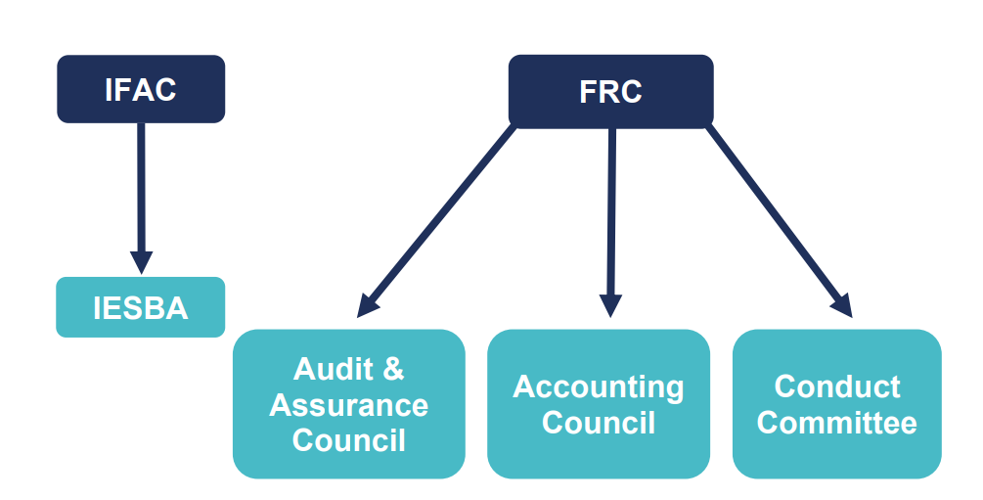

Slide 5
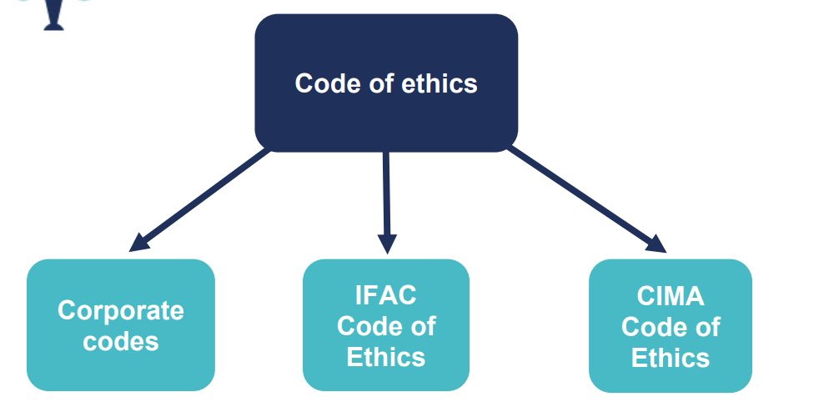

Slide 6
CIMA Code of Ethics
Integrity
Objectivity
Professional competence and due care
Confidentiality
Professional behaviour

Slide 7

Integrity
to be straightforward and honest in all professional and business relationships

Slide 8

Objectivity
not to compromise professional or business judgments because of bias, conflict of interest or undue influence of others.

Slide 9

Professional competence and due care
Attain and maintain professional knowledge and skill at the level required to ensure that a client or employing organisation receives competent professional service, based on current technical and professional standards and relevant legislation; and
Act diligently and in accordance with applicable technical and professional standards.

Slide 10

Confidentiality
to respect the confidentiality of information acquired as a result of professional and business relationships.

Slide 11

Professional behaviour
to comply with relevant laws and regulations and avoid any conduct that the professional accountant knows or should know might discredit the profession.

Slide 12
The scenario
You are working at a small business on a finance training scheme.
You have been there for one year and have completed the Operational Level of the CIMA Professional Qualification.
You work in a team of three: you, your manager, and a third-year graduate trainee. Your team should have more people, but recent budget cuts led to losing two members of your team, and those who remain are under significant pressure to deliver work quickly.
Your line manager finds you in the office one afternoon and asks you to complete some complicated revenue calculations before you leave for the day.
You don’t feel confident doing this. It’s a new type of work that you have briefly touched upon in your studies, but you have no practical experience. It will take hours, and the other members of the team will be going home very soon.

Slide 13

What does CIMA code of ethics talk?
CIMA Code of Ethics: The Code applies to both members and students, guiding ethical decision-making in professional situations.
Competence and Due Care: Section 113 of the Code requires maintaining professional skills. If you lack experience for a task, it’s essential to address this rather than risk errors.
Threats to Competence: Section 260.6 A7 identifies threats like insufficient time and training. Safeguards include seeking help, doing extra research, or consulting superiors.

Slide 14
Honesty and Transparency: Be open about your concerns with your manager, referencing the Code. Express that you lack experience and that rushing could lead to mistakes.
Proposing a Solution: Suggest collaborating with a more experienced team member to complete the task, which reduces errors and allows you to gain experience.
Escalation: If your manager insists on the task, consider discussing your concerns with a mentor or trainee program leader for support.
Professional Development: After addressing the issue, request a meeting to ensure you’re gaining the practical experience necessary to complement your studies.

Slide 15

Threats and Safeguard

Slide 16
Definition
In the context of professional ethics, particularly in accounting and auditing, a threat refers to a situation that could impair an individual's ability to act with integrity, objectivity, or professionalism. These threats can lead to bias or compromised judgment, undermining the quality of the work being done.
On the other hand, safeguards are measures put in place to reduce or eliminate these threats. Safeguards help ensure that professionals can act independently and ethically, despite the potential threats.

Slide 17
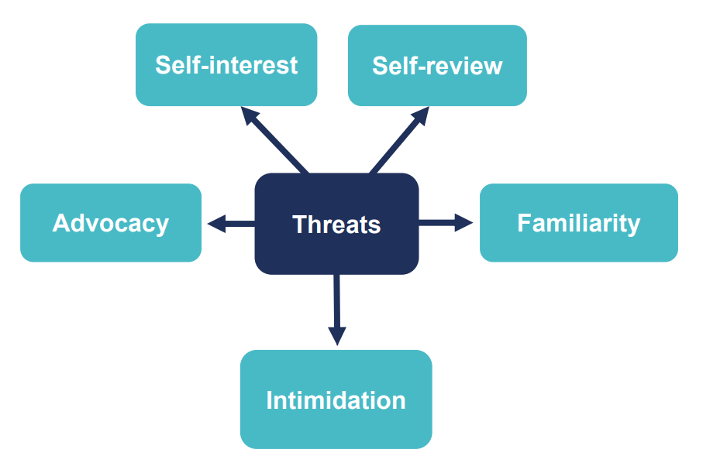

Slide 18
Five categories of common threat
Self-interest threats can occur as a result of your own or your close family's interests – financial or otherwise. These threats often result in what is commonly called a 'conflict of interest' situation. Working in business, a self-interest threat could result from concern over job security, or from incentive remuneration arrangements. For those in practice it might be the possibility of losing a client or holding a financial interest in a client.
Self-review threats occur when you are required to re-evaluate your own previous judgement, for example if you have been asked to review and justify a business decision you made, or if you are reporting on the operation of financial systems that you were involved in designing or implementing.

Slide 19
Familiarity threats can be present when you become so sympathetic to the interests of others as a result of a close relationship that your professional judgement becomes compromised. Sometimes this can result from long association with business contacts who influence business decisions, long association with colleagues, or from accepting gifts or preferential treatment from a client.
Intimidation threats occur when you are deterred from acting objectively by actual or perceived threats. It could be the threat of dismissal over a disagreement about applying an accounting principle or reporting financial information, or it could be a dominant personality attempting to influence the decision making process.
Advocacy threats can be a problem when you are promoting a position or opinion to the point that your subsequent objectivity is compromised. It could include acting as an advocate on behalf of an assurance client in litigation or disputes with third parties. In general, promoting the legitimate goals of your employer does not create an advocacy threat, provided that any statements you make are not misleading.

Slide 20
Threats examples- identify threats for each
Preparing accounts for a campaign group of which the accountant is a leading member
Preparing accounts under an unrealistically imposed deadline by a major client
Preparing accounts for your close relative's business
Preparing accounts for your spouse's business
Preparing accounts and providing a basic audit function on those accounts

Slide 21
Ans
Preparing accounts for a campaign group of which the accountant is a leading member C. Advocacy threats The accountant might be seen as advocating for the interests of the campaign group, which could impair objectivity.
Preparing accounts under an unrealistically imposed deadline by a major client E. Intimidation threats The pressure from the client to meet an unreasonable deadline could intimidate the accountant into compromising professional judgment.
Preparing accounts for your close relative's business D. Familiarity threats The close relationship with the relative could affect the accountant's objectivity due to emotional involvement or bias.
Preparing accounts for your spouse's business D. Self-interest threats The close relationship with the spouse could affect impartiality and professional judgment.
Preparing accounts and providing a basic audit function on those accounts B. Self-review threats When the accountant prepares the accounts and also reviews them as part of the audit, it creates a conflict of interest as the accountant might not be impartial when reviewing their own work.

Slide 22
Safegaurds
The CIMA code does not describe all the safeguards that could be implemented, but instead gives general guidance for handling ethical issues, both for accountants working in business and for those in practice. Safeguards include, but are not restricted to:
educational, training and experience requirements for entry into the profession
continuing professional development requirements
corporate governance regulations
professional standards
professional or regulatory monitoring and disciplinary procedures

Slide 23
external review of the reports, returns, communications or information produced by a member and carried out by a legally empowered third party.
the employing organisation’s systems of corporate oversight or other oversight structures
the employing organisation’s ethics and conduct programmes
recruitment procedures in the employing organisation emphasising the importance of employing high calibre competent staff
the employing organisation's grievance procedures
strong internal controls • appropriate disciplinary processes
leadership that stresses the importance of ethical behaviour and the expectation that employees will act in an ethical manner
timely communication of the employing organisation’s policies and procedures
consultation with another appropriate professional

Slide 24
Various Ethical threats and safeguards

Slide 25
1. Conflict Between Employer Requirements and Fundamental Principles
Ethical Threat:
The accountant may be pressured by the employer to act contrary to laws, regulations, or professional standards.
Safeguards:
Obtaining advice from the employer, professional organization, or professional advisor.
The employer providing a formal dispute resolution process.
Legal advice to ensure compliance with applicable laws and regulations.

Slide 26
2. Preparation and Reporting on Information
Ethical Threat:
The accountant may be pressured to provide misleading or false information, which undermines fairness, objectivity, and honesty in reporting.
Safeguards:
Consultation with superiors in the employing company to ensure transparency.
Consultation with those charged with governance (such as the board of directors or audit committee) to align on ethical standards.
Consultation with the relevant professional body to ensure the information complies with professional standards.

Slide 27
3. Having Sufficient Expertise
Ethical Threat:
An accountant might be pressured to take on tasks beyond their level of expertise due to time constraints, lack of information, or insufficient experience, leading to unethical behavior or inadequate reporting.
Safeguards:
Obtaining additional advice or training to ensure that the accountant has the necessary skills.
Negotiating more time to carry out duties effectively and with due diligence.
Obtaining assistance from someone with relevant expertise to fill gaps in knowledge or experience.

Slide 28
4. Financial Interests
Ethical Threat:
Situations where the accountant or a close family member has a financial interest in the company (e.g., receiving bonuses based on the financial results the accountant prepares or owning shares in the company) could impair objectivity.
Safeguards:
Remuneration being determined by other members of management to avoid conflicts of interest.
Disclosure of relevant interests to those charged with governance (e.g., board members).
Consultation with superiors or the relevant professional body to assess potential conflicts of interest.

Slide 29
5. Inducements with Intent to Improperly Influence Behavior
Ethical Threat:
Inducements such as gifts, entertainment, or other incentives offered to influence the accountant's behavior unethically.
Safeguards:
Do not accept the inducement! Simply rejecting the offer protects objectivity.
Inform relevant third parties (e.g., senior management, professional associations) about the inducement after seeking legal advice.
Consider amending or terminating the business relationship with the party offering the inducement to avoid future ethical concerns.

Slide 30
6. Inducements with No Intent to Improperly Influence Behavior
Ethical Threat:
This involves situations where inducements are offered without malicious intent, such as routine invitations to lunch or small gifts, which may still raise ethical concerns depending on the context.
Safeguards:
Being transparent with senior management about offering or accepting such inducements.
Registering the inducement in a log maintained by the employing organization or counterparty to ensure accountability and transparency.

Slide 31
7. Confidential Information
Ethical Threat:
The accountant might face pressure to disclose confidential information, especially in cases where the need for disclosure conflicts with legal or professional obligations (e.g., anti-money laundering regulations).
Safeguards:
Disclose information in compliance with relevant statutory requirements (e.g., money laundering regulations or other legal obligations).

Slide 32
8. Whistleblowing
Ethical Threat:
Situations where the accountant is aware of unethical or illegal actions taken by the client and needs to disclose information. This can lead to conflicts between maintaining confidentiality and fulfilling legal or ethical obligations to report wrongdoing.
Safeguards:
Follow the disclosure provisions of the employer to ensure ethical obligations are met.
If necessary, disclosure should be based on an assessment of:
Legal obligations to disclose.
Whether members of the public will be adversely affected.
The gravity and likelihood of repetition of the unethical behavior.
The reliability of the information.
The reasons why the employer does not want to disclose the information.

Slide 33
Two different approaches to formulating a code of ethics
a rules-based approach
a framework approach.

Slide 34
The Seven Principles of Public Life
Selflessness
Holders of public office should act solely in terms of the public interest. They should not do so in order to gain financial or other benefits for themselves, their family or their friends.
Integrity
Holders of public office should not place themselves under any financial or other obligation to outside individuals or organisations that might seek to influence them in the performance of their official duties.
Objectivity
In carrying out public business, including making public appointments, awarding contracts, or recommending individuals for rewards and benefits, holders of public office should make choices on merit.

Slide 35
Accountability
Holders of public office are accountable for their decisions and actions to the public and must submit themselves to whatever scrutiny is appropriate to their office.
Openness
Holders of public office should be as open as possible about all the decisions and actions that they take. They should give reasons for their decisions and restrict information only when the wider public interest clearly demands.
Honesty
Holders of public office have a duty to declare any private interests relating to their public duties and to take steps to resolve any conflicts arising in a way that protects the public interest.
Leadership
Holders of public office should promote and support these principles by leadership and example. Given the trends towards less trust and more desire for accountability, it is therefore of little surprise that management accountants are now expected to do more than merely follow the rules.

Slide 36
Personal qualities
Reliability: The ability to be trusted and dependable, consistently delivering quality work as agreed. An unreliable accountant likely falls short of professional competence standards.
Responsibility: Being accountable for one's decisions and actions. A responsible accountant makes informed decisions and is willing to answer for them, particularly in professional judgment situations.
Timeliness: Delivering work on time, meeting expectations, and demonstrating diligence in managing tasks effectively.
Courtesy: Demonstrating politeness and good manners, while respecting societal values, especially in the context of avoiding discriminatory behavior (e.g., racist, sexist).
Respect: Demonstrating esteem for others, listening to differing viewpoints, and considering them for well-rounded decision-making, without unnecessary deference.

Slide 37
Accountability, social responsibility and professional scepticism

Slide 38
Accountability
Professional accountants are responsible for their actions and must be able to explain them. They are accountable to the public, clients, and employers, with oversight from bodies like the FRC in the UK. Failure to meet accountability can lead to complaints and disciplinary actions.
Example:
Client Accountability: A management accountant working for a company is accountable to their employer to ensure that financial decisions made align with the company’s objectives. If their decisions lead to financial losses due to negligence, the employer can seek redress through formal complaints or disciplinary processes.

Slide 39
Social Responsibility
Accountants have a broader role in fulfilling their public duty, which includes social and corporate responsibility. This encompasses their impact on stakeholders (e.g., employees, customers, suppliers) and the community. Corporate Social Responsibility (CSR) is a key part of ethical policies, ensuring companies act responsibly toward their stakeholders and society.
Example
CSR Initiatives: A company may implement a Corporate Social Responsibility (CSR) program, such as reducing its carbon footprint or donating a percentage of profits to charity. As part of their responsibility, an accountant would ensure these initiatives are properly reported, both internally to management and externally to stakeholders.

Slide 40
Professional Scepticism
Professional scepticism is crucial for accountants, particularly in auditing. It involves questioning management's assertions and being alert to errors or fraud in financial statements. While auditors start with a neutral view, they increase scrutiny if evidence suggests misstatements. The appropriate level of scepticism varies based on experience, training, and company culture. It is vital to balance scepticism with independence and objectivity, with ethical standards guiding auditors to avoid overtrusting clients.
Example
Challenging Assertions: During an audit, the auditor challenges management’s claim about the accuracy of inventory valuation, as the valuation seems unusually high. The auditor seeks additional evidence, including third-party verification, to ensure the inventory value is correct and not overstated to present a better financial position.

Slide 41
Responsible business
is about an organisation’s commitment to operating in a way that is economically, socially and environmentally sustainable
means ensuring this commitment prevails while still upholding the interests of various stakeholder groups.

Slide 42
Business ethics
is the application of values such as integrity, fairness, respect and openness to organisational behaviour
apply to all strategic and operational aspects of business conduct, including sales and marketing techniques, accounting practices and the treatment of suppliers, employees and customers
may also be termed “business principles”, and are usually set out in a code of ethics or similar policy document.

Slide 43
Ethical performance
is the extent to which an organisation’s behaviour aligns with its stated ethical values and commitments.

Slide 44
Ethical management information
allows an assessment of the organisation’s ethical performance, such as the efficacy of relevant policies and procedures, occurrence of breaches of relevant policies or codes, stakeholder opinion and other metrics
may include specific ethics information, such as the number of employees attending ethics training or calls to an ethics helpline, as well as routine management and risk information
will often originate from multiple sources within the business, and can be either quantitative or qualitative.

Slide 45
Integrated reporting
describes an approach to corporate reporting. It is based on both financial and nonfinancial information that demonstrates the linkages between an organisation’s strategy, governance and financial performance as well as the social, environmental and economic context within which it operates.

Slide 46
Additional Ethical issues within organisations
Security of information
Safety and security in the workplace
Discrimination
Conflicts of interest
Bribery
Environmental
Supply chain
Responsible marketing
Human rights
Whistle blowing
Fairness of remuneration.

Slide 47
Good practice:
Root the code in core values e.g. trust, integrity
Give a copy to all staff
Provide a way to report breaches in a confidential manner
Include ethical issues in corporate training programmes
Set up a board committee to monitor the effectiveness of the code
Report on the code’s use in the annual report
Make conformity to the code part of a contract of employment
Make the code available in the language of those staff located overseas
Make copies of the code available to business partners, including suppliers
Make a named individual responsible for code implementation
Review code in light of changing business challenges
Make sure senior staff ‘walk the talk’

Slide 48
Poor practice:
Just pinning the code to the notice board
Failing to obtain board commitment to the code
Leaving responsibility for the code’s effectiveness to HR or any other department
Failing to find out concerns of staff at different levels
Failing to feature the code in induction training and management development activities
Having no procedure for revising the code regularly
Making exceptions to the code’s application
Failing to follow up on breaches of the code’s standards
Unhelpful example by corporate leaders
Neglecting to have a strategy to integrate corporate values and standards into the running of the business
Treating the code as confidential or a purely internal document
Making it difficult for staff to have direct access to the code or the person who is responsible for it.

Slide 49
Summary
Legal frameworks, regulations and standards for business; The role of national ‘Professional Oversight Boards for Accountancy’ and ‘Auditing Practices Boards’ The role of international accounting bodies e.g. IFAC. Rules-based and framework approaches to ethics; Organisational and personal values, The personal qualities of reliability, responsibility, timeliness, courtesy and respect, The fundamental ethical principles, Continual Professional Development (CPD), The concepts of independence, scepticism, accountability and social responsibility. Good and poor practices.

